Slide 1
Session 2
Four steps of change

Slide 2
Topics for the session
Four steps for change
Deciding if you really want this.
Freedom of information
Setting Goals

Slide 3
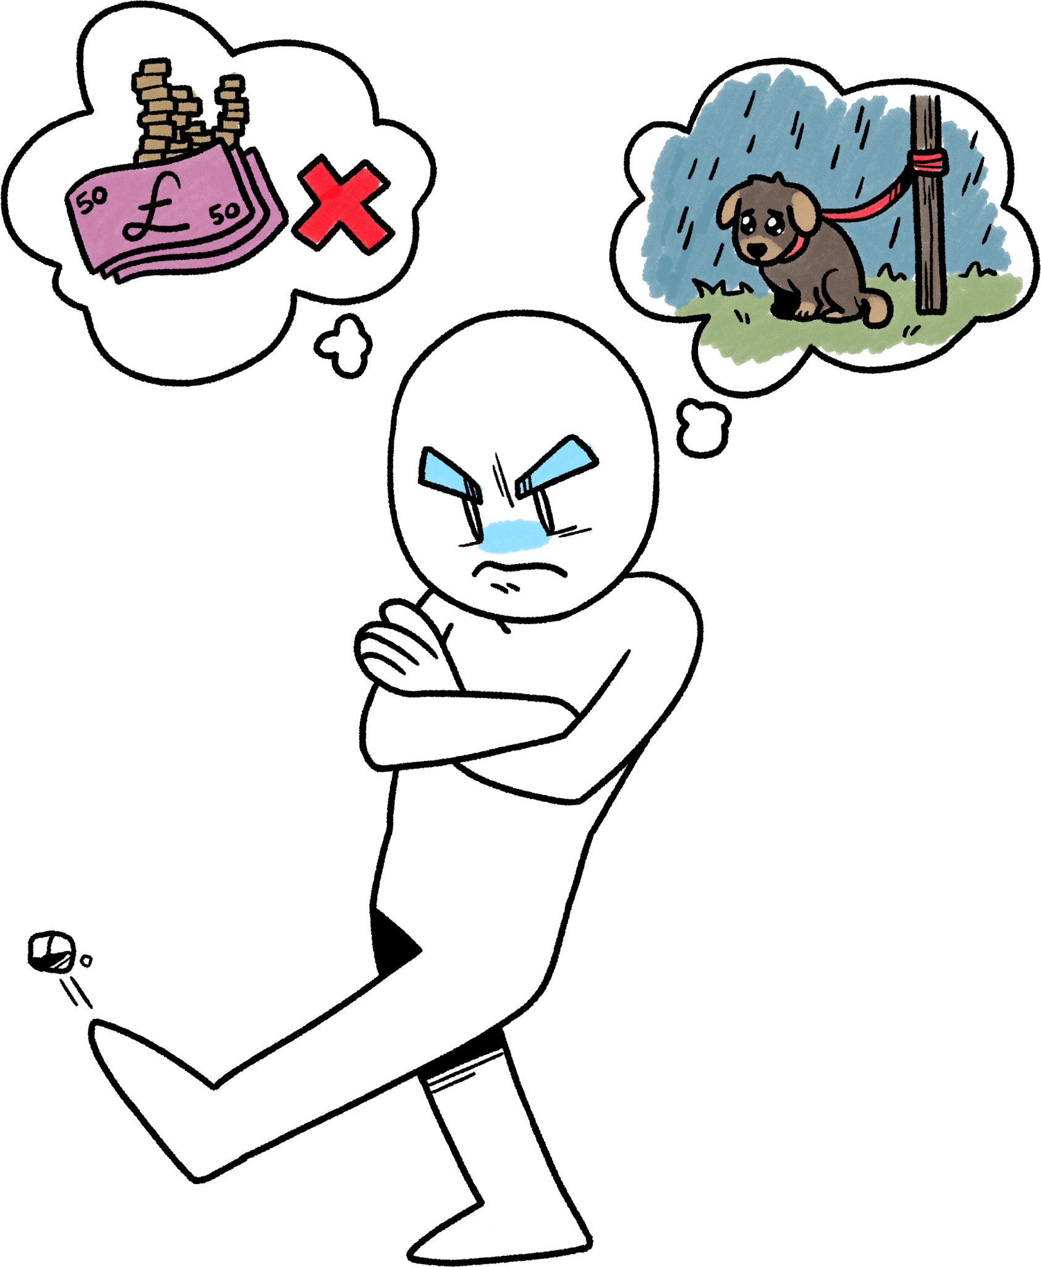
Social Change
Some things we’re annoyed by…
Animal abuse
Glass siblings
I’m not rich
A&E waits are too long
People should use the Oxford comma
The lack of support for homeless people

Slide 4
Change
Check in with yourself
Get Information
Setting Goals
Risks

Slide 5
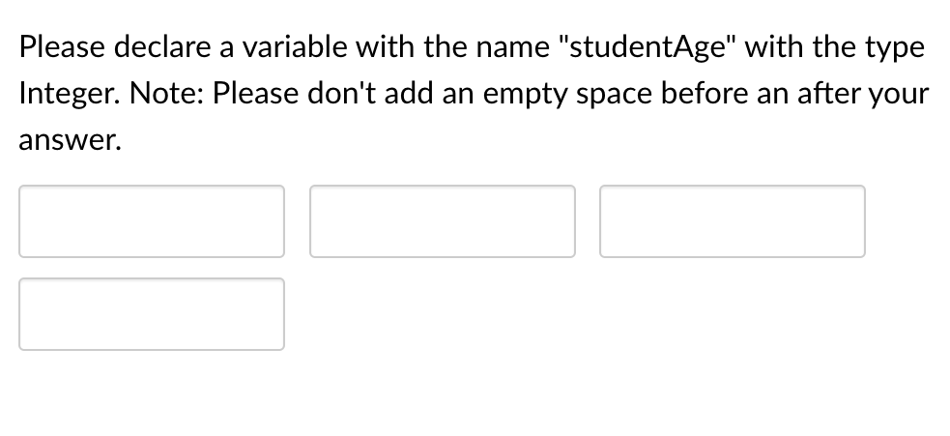
Do you want change or to keep complaining?
Many people find the below image very annoying.

Slide 6
Do you want change or to keep complaining?
“I hate when text boxes won’t let me put in a space”
“Uggh, the code to remove spaces is literally shorter than the error message I’ve been given”
“Because this product is lazy, it’s hard to use for people with access difficulties”
“Your local government website does not meet the international WCAG 2.1 AA accessibility standard because of X, Y, Z, - this is a particular problem for four of my colleagues and two of my family members who have access difficulties”
Look at the sentences on the right. Which ones are just complaining and which ones might change something? What’s the differences?

Slide 7
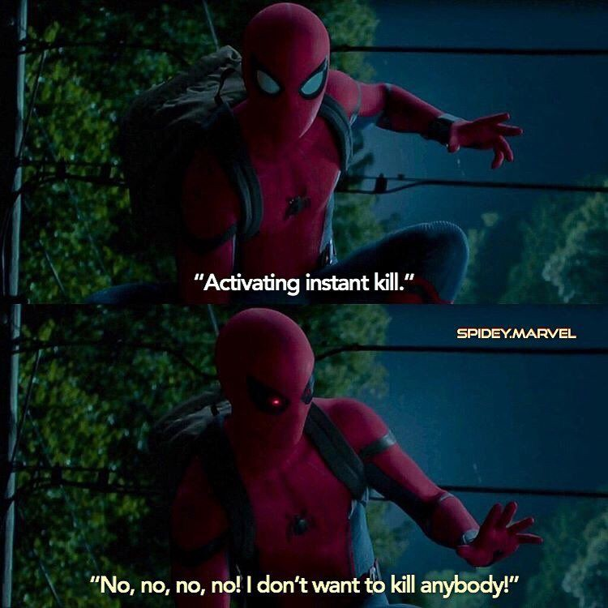
Tone is also everything
“Your local government website does not meet the international WCAG 2.1 AA accessibility standard because of X, Y, Z, - this is a particular problem for four of my colleagues and two of my family members who have access difficulties”
“Hi there, can you tell me when you might be upgrading your website; I want to tell you some things about the design.
“Excuse me, did you know that you have this bug?

Slide 8
Getting information

Slide 9
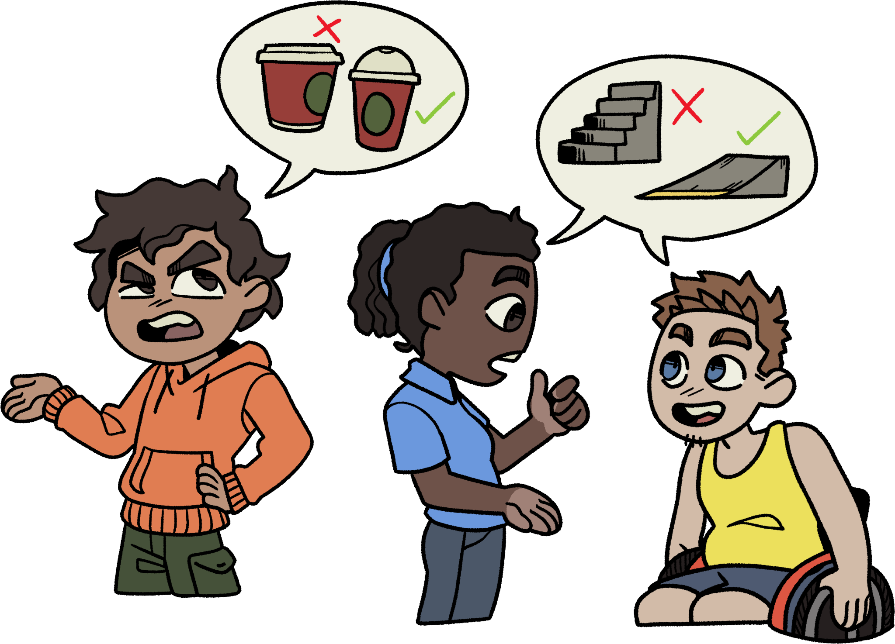
Information
Information is everything. Always will be.
Is the thing you are complaining about, an actual issue?
Does it affect other people?
Is anyone else mad about it?

Slide 10
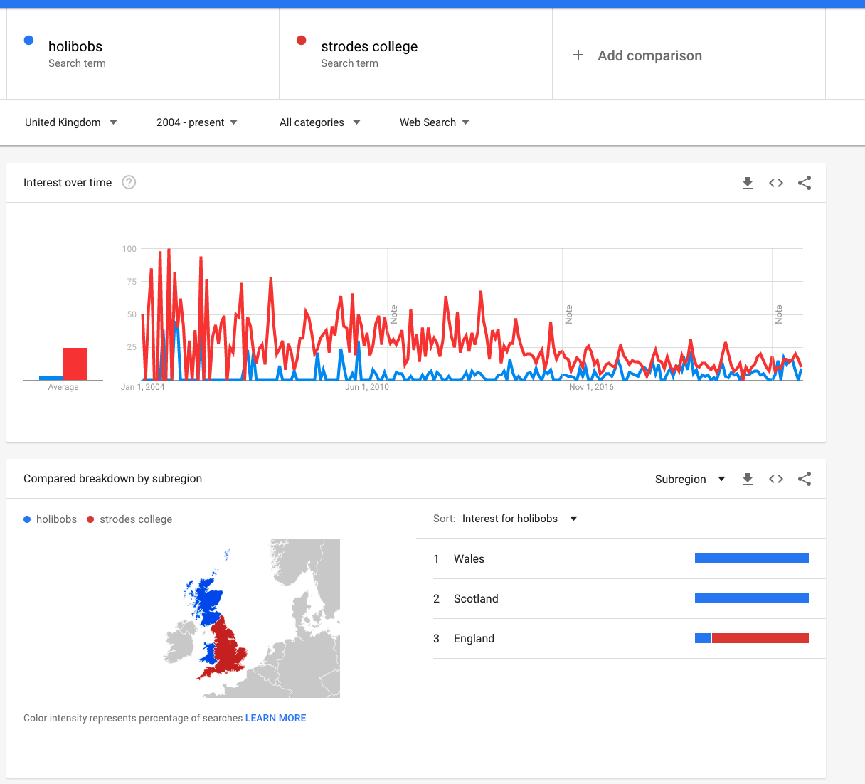
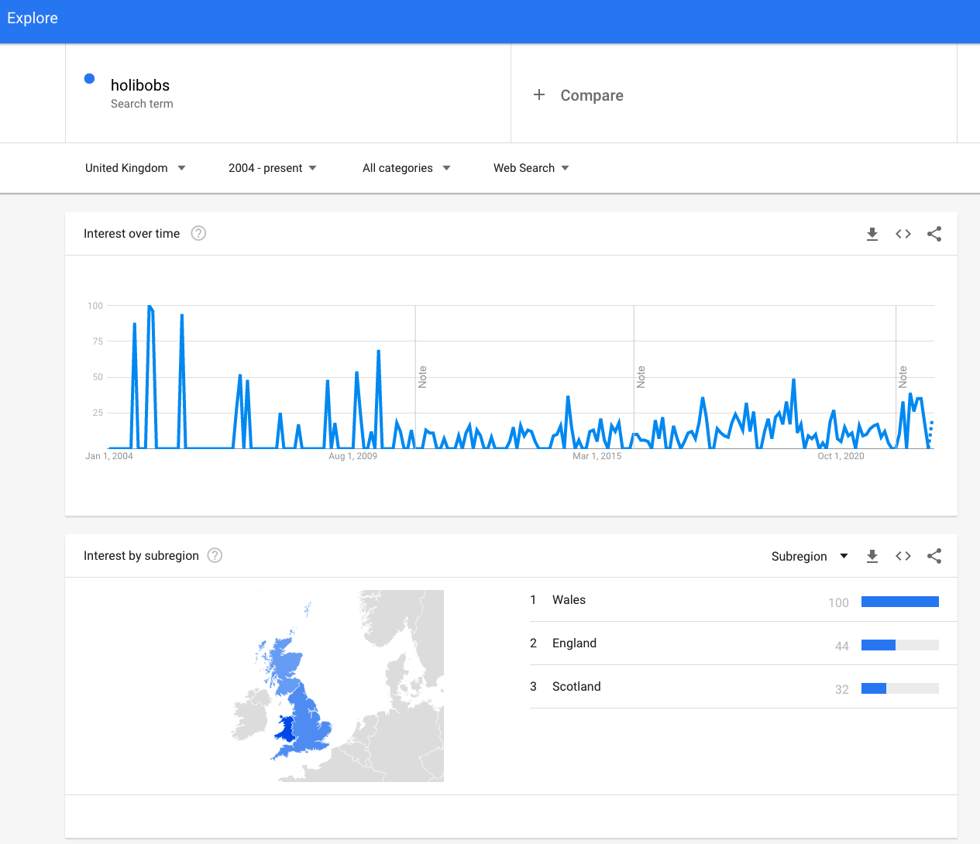
“Hollibobs”

Slide 11
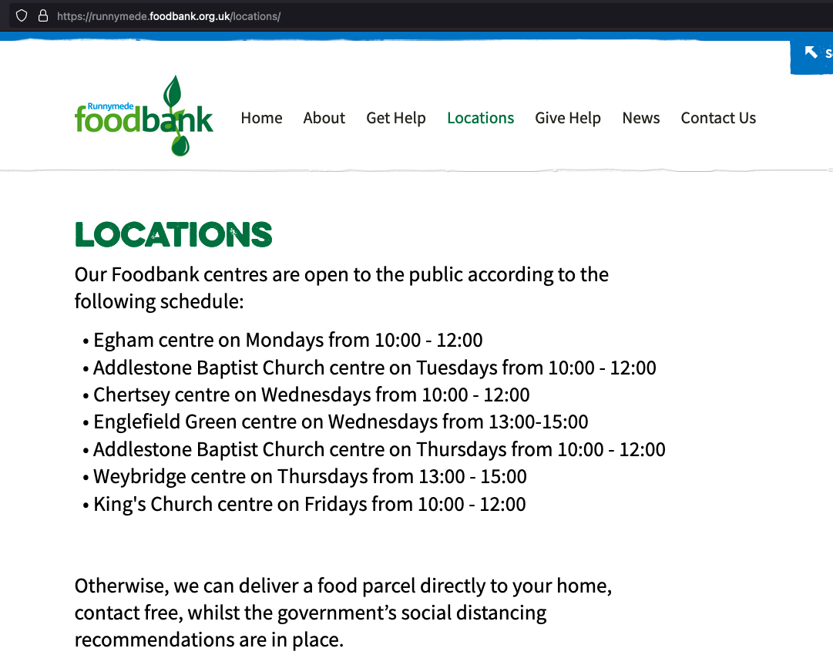
Food Waste
Sometimes someone is already dealing with the
problem. Other organisations can give you information, or ideas for how to help, and they can protect you.

Slide 12
Missing Children
We know of a young person who has largely been abandoned by the school system and isn’t on any school roll.
Is he alone?
How would we find out?

Slide 13
Glass Siblings
Sibs is the UK charity for brothers and sisters of disabled children and adults.
These ‘glass siblings’ can end up with their own unique set of issues.
We spoke to the charity CEO and she told us they were having a big problem even guessing at the number of glass siblings there were in the UK.
How would you go about doing that?

Slide 14
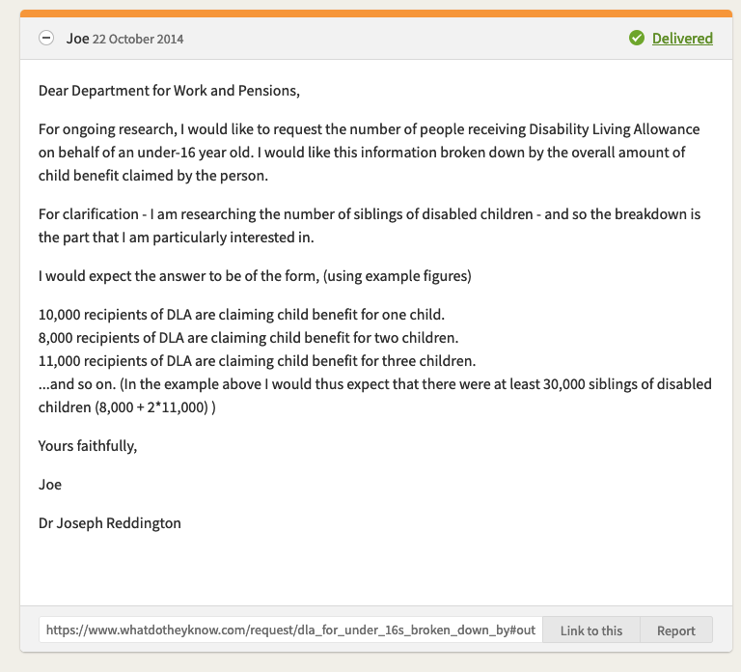
So we sent this email.
Freedom of Information Law in the UK requires that public bodies answer any reasonable question asked of them.
It is an incredible tool.

Slide 15
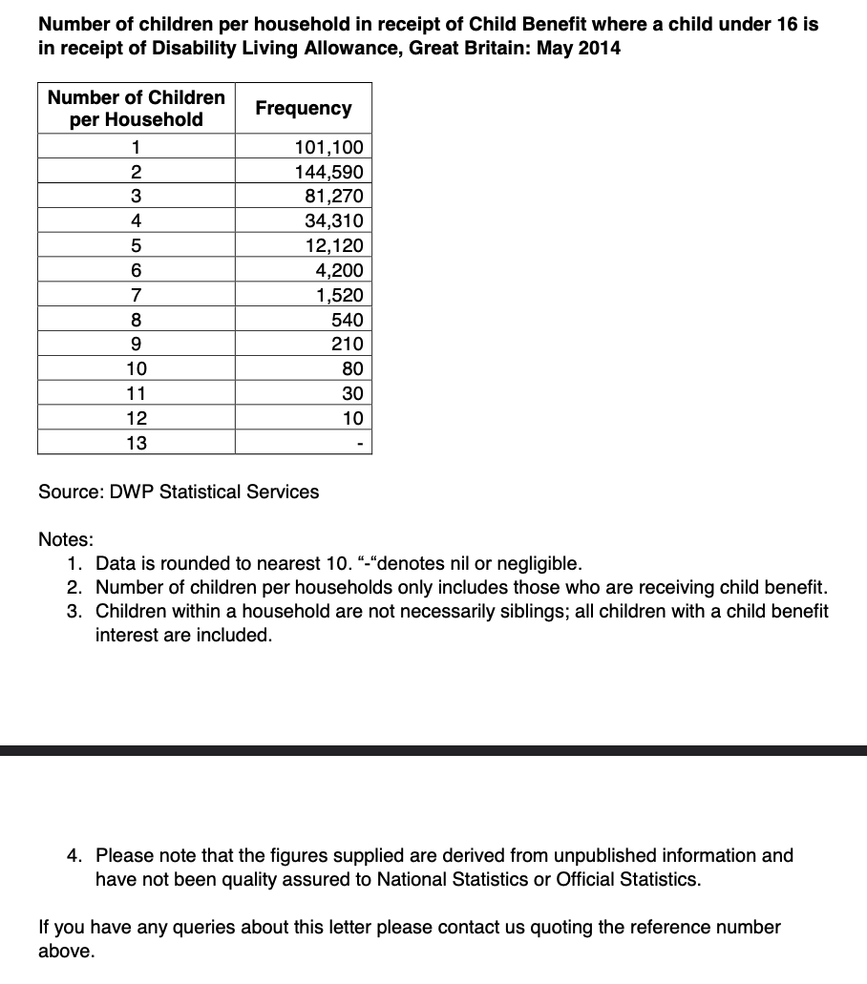
Turns out the answer is about half a million.

Slide 16
Missing Children
We know of a young person who has largely been abandoned by the school system and isn’t on any school roll.
Do we now have any ideas?

Slide 17
Missing Children
We know of a young person who has largely been abandoned by the school system and isn’t on any school roll.
Do we now have any ideas?
If we did a Freedom of Information request, what are the risks?

Slide 18
Security
What security issues do we need to consider?

Slide 19
Security
What security issues do we need to consider?
Losing your job
Public Shaming
Active resistance from staff.

Slide 20
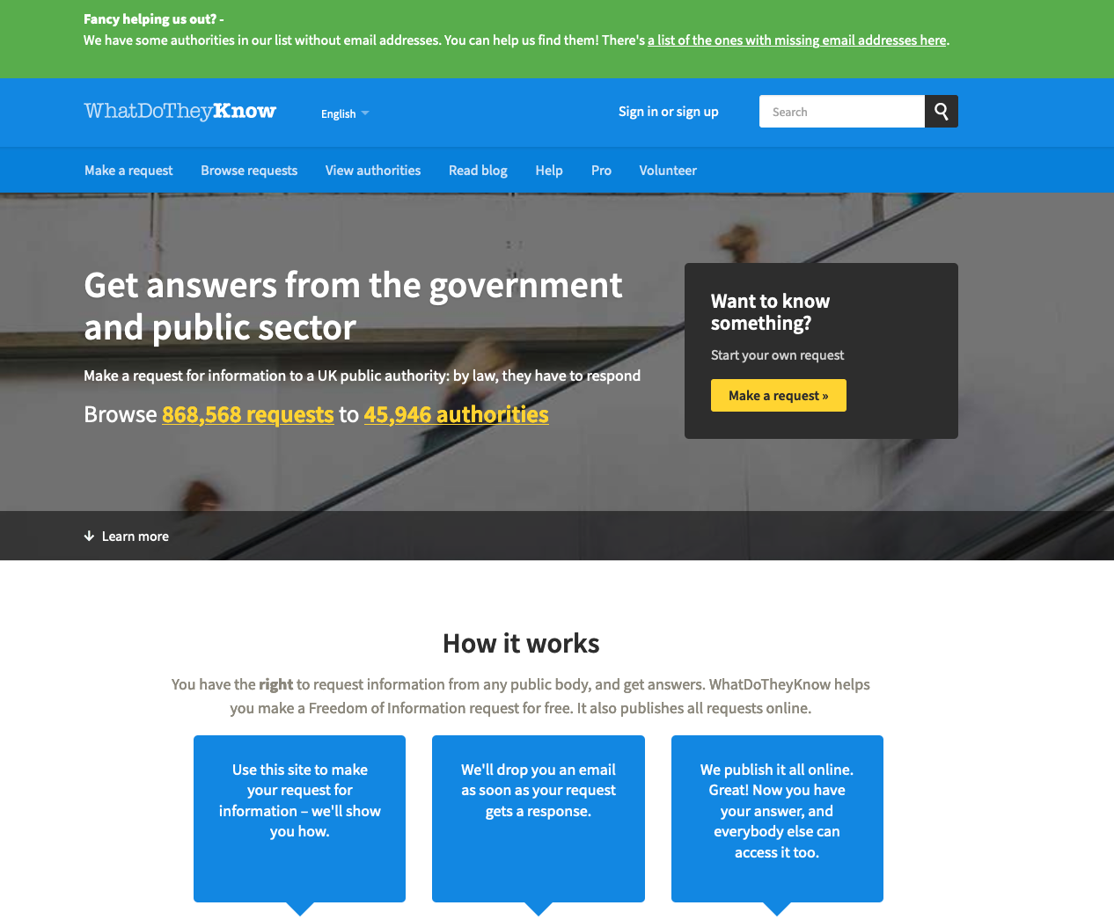

Slide 21
So, what do you need to know and how do you find it out?
Just ask…
National statistics
Freedom of information
Smart people who agree with you
Smart people who don’t
(All of these should be done before complex things like Freedom of Information)
Obviously a lot of Googling

Slide 22
Step 3: Setting Goals

Slide 23
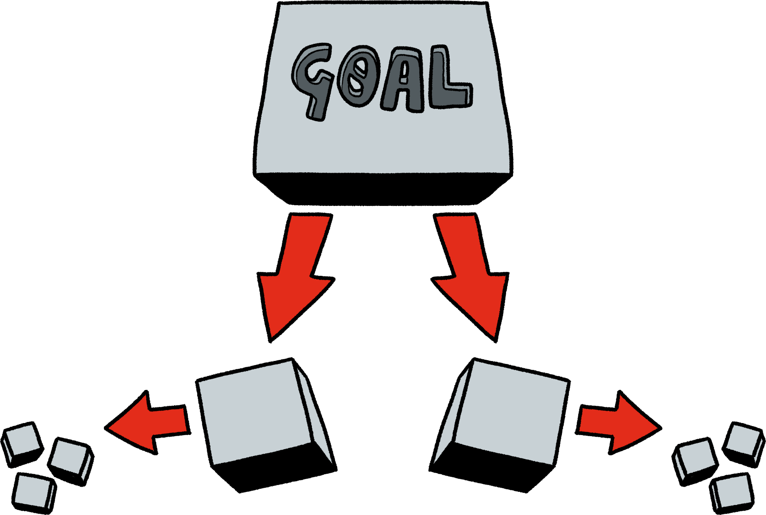
Big Goals get broken down into small pieces
“End animal testing”
“End animal testing in Bedfordshire”
“Local shops don’t stock products tested on animals”
“In our house, we don’t use products tested on animals”
A law banning all animal testing in UK
“Become rich”
“Have a million pounds in the bank”
“Always have enough money to look after my parents”
“Drive a nice car”

Slide 24
Big Goals get broken down into small pieces
“End animal testing”
“End animal testing in Bedfordshire”
“Local shops don’t stock products tested on animals”
“In our house, we don’t use products tested on animals”
A law banning all animal testing in UK
“Become rich”
“Have a million pounds in the bank”
“Always have enough money to look after my parents”
“Drive a nice car”
Are these…
Specific?
Measurable?
Achievable?
Realistic?
Timed?
To answer these questions, you probably need more information…

Slide 25
So you go and get more information…

Slide 26
So you go and get more information…
“The college officially announces it will work towards fairtrade certification from 2025”
“Get family to agree to remove all animal tested products from my house by the end of this week”
“This week, write to my MP asking them to support better animal safety laws”
“By 2028 I want to be supporting myself with no loans”
“By 2030 I want to have bought my mum and dad a house”
“End animal testing”
“End animal testing in Bedfordshire”
“Local shops don’t stock products tested on animals”
“In our house, we don’t use products tested on animals”
A law banning all animal testing in UK
“Become rich”
“Have a million pounds in the bank”
“Always have enough money to look after my parents”
“Drive a nice car”

Slide 27
Summary
First, find out if you just like complaining
Information is the most important thing
Make a goal and be prepared to change it often.

